Slide 1
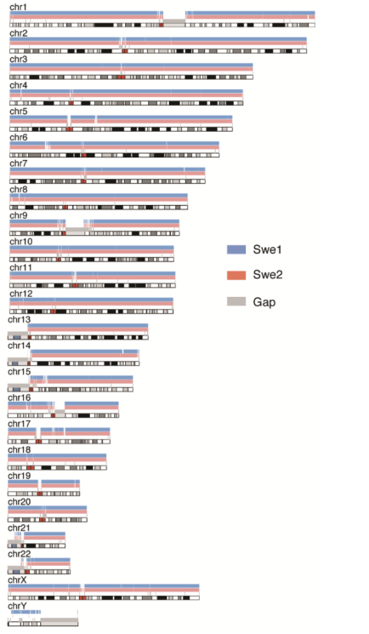
PacBio GENOME ASSEMBLY
De novo Assembly of Two Swedish Genomes Reveals Missing Segments
from the Human Reference (hg38)
Ameur et al. Genes, 2018
10 Mb of the 2 genomes are absent from hg38 reference
1 Mb are assigned to chr. Y
6 Mb are shared with a Chinese personal genome
Inclusion of these sequences in GRCh38 genome radically
improves alignment and variant calling from short-read data :
re-analysis :
yields > 75,000 putative novel single nucleotide variants (SNVs)
removes > 10,000 false positive SNV calls per individual
It becomes possible to represent specific population groups by assembly of representative genomes from different populations.

Slide 2
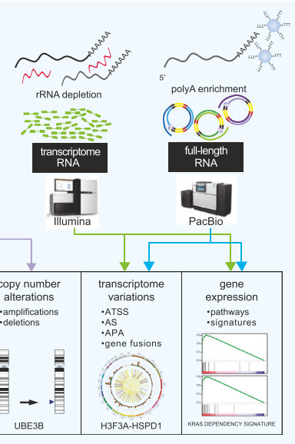

PacBio cDNA SEQUENCING
Hybrid full-length transcriptome in metastatic ovarian cancer
Jing et al. Oncogene 2019
ATSS : alternative transcription start sites
AS : alternative splicing
APA : alternative polyadenylation sites

Slide 3
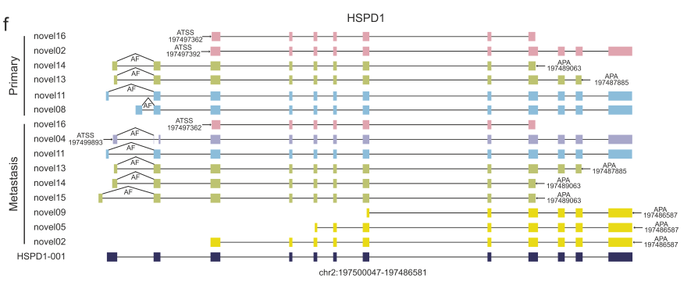
PacBio cDNA SEQUENCING
Hybrid full-length transcriptome in metastatic ovarian cancer
Jing et al. Oncogene 2019
Primary
tumor
Metastases
Long-read full-length transcriptome analysis
improves molecular diagnostic
reveals novel therapeutic vulnerabilities

Slide 4
SEQUENCING cDNA USING CIRCULAR CONSENSUS SEQUENCES
Genome annotation of the parasitic hookworm Ancylostoma ceylanicum
using single molecule mRNA sequencing
Magrini et al. BMC Genomics, 2018
PacBio
sequencing
RNA cDNA 193 000 CCS
Increased the total genomic exon length by 1.9 Mb (12.4%)
1609 (9.2%) new genes

Slide 5
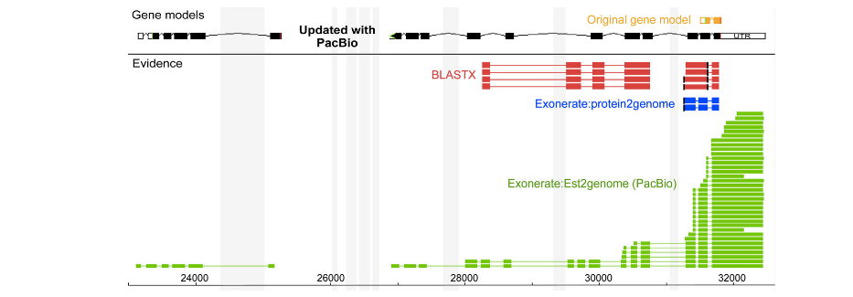
SEQUENCING cDNA USING CIRCULAR CONSENSUS SEQUENCES
Genome annotation of the parasitic hookworm Ancylostoma ceylanicum
using single molecule mRNA sequencing
Magrini et al. BMC Genomics, 2018
PacBio
sequencing
RNA cDNA 193 000 CCS
Increased the total genomic exon length by 1.9 Mb (12.4%)
1609 (9.2%) new genes
Original gene model

Slide 6
SEQUENCING cDNA USING CIRCULAR CONSENSUS SEQUENCES
Genome annotation of the parasitic hookworm Ancylostoma ceylanicum
using single molecule mRNA sequencing
Magrini et al. BMC Genomics, 2018
PacBio
sequencing
RNA cDNA 193 000 CCS
Increased the total genomic exon length by 1.9 Mb (12.4%)
1609 (9.2%) new genes
Original gene model

Slide 7
SEQUENCING cDNA USING CIRCULAR CONSENSUS SEQUENCES
Genome annotation of the parasitic hookworm Ancylostoma ceylanicum
using single molecule mRNA sequencing
Magrini et al. BMC Genomics, 2018
PacBio
sequencing
RNA cDNA 193 000 CCS
Increased the total genomic exon length by 1.9 Mb (12.4%)
1609 (9.2%) new genes
Original gene model

Slide 8
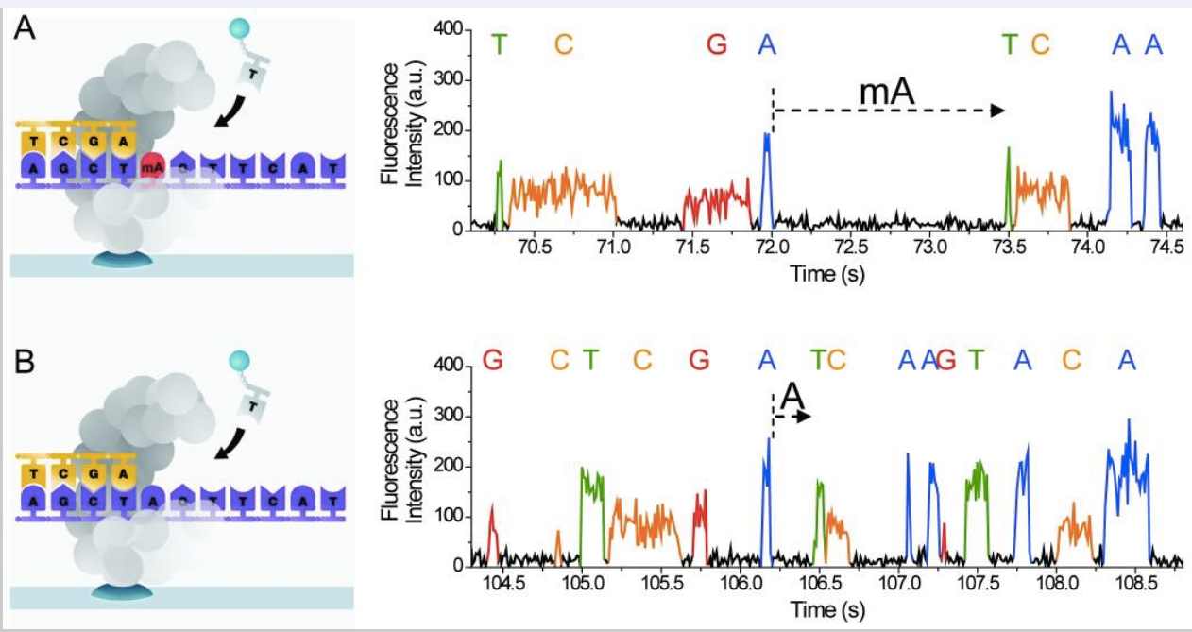
DETECTION OF MODIFIED BASES
from Fusberg et al. Nature Methods (2010)
Detection of 5mA and possible detection of other modified bases : 5mC, 5-hmC, etc.
but with strong influence of sequence contexts (requires high coverage)
Feng et al. PLOS Comput Biol (2013)

Slide 9
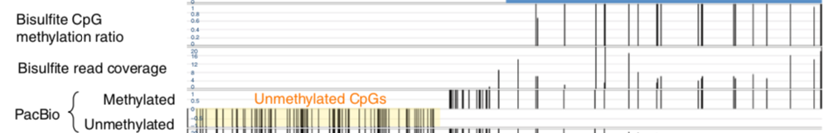
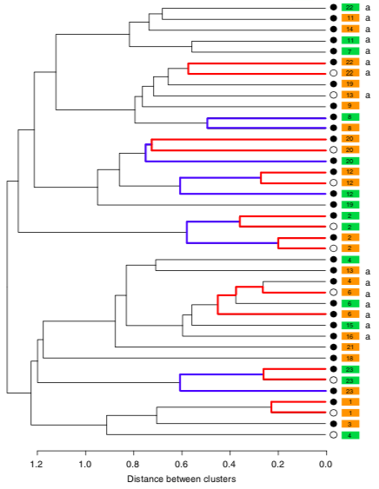
PacBio DETECTION OF MODIFIED BASES
Centromere evolution and CpG methylation during vertebrate speciation
Ichikawa et al. Nature Communications 2009
Long-read genome assembly of three inbred medaka strains that undergo speciation
Variation of CpG methylation occurred after the divergence of two medaka strains demonstrating that centromeres accumulated epigenetic diversity during speciation

Slide 10

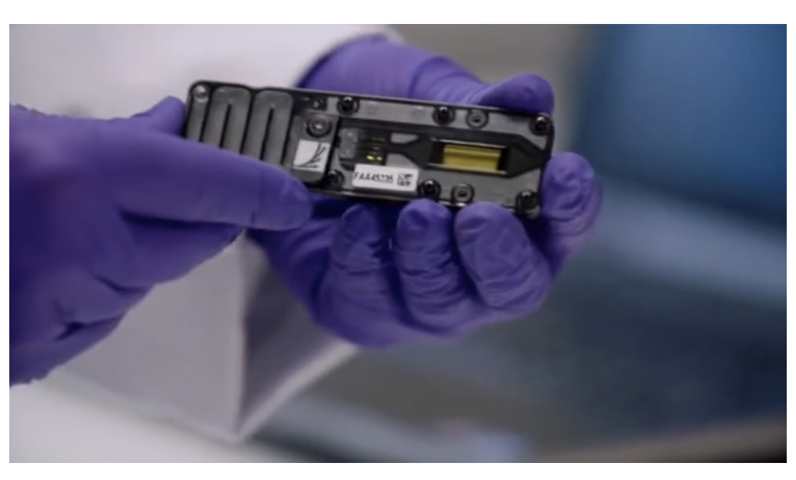

Slide 11
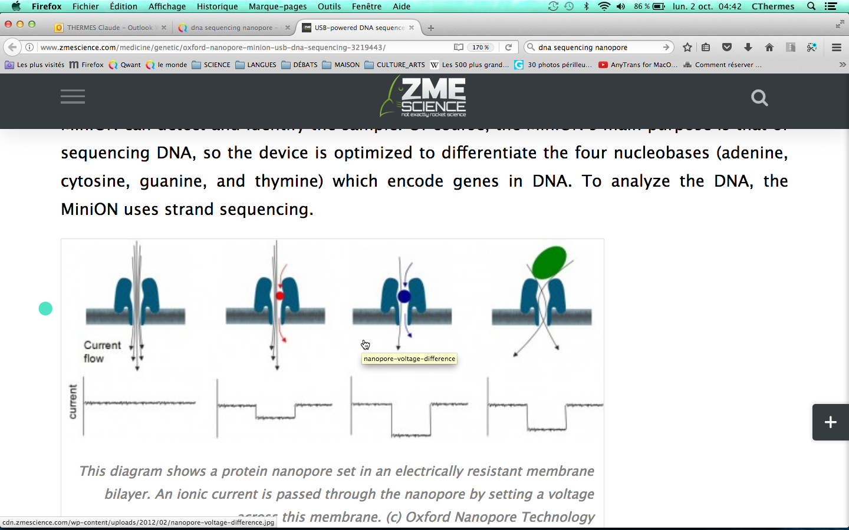


BASIC CONCEPTS
Upper chamber
A
Ionic solution
nanopore
Ionic solution
Lower chamber
time
time
time

Slide 12
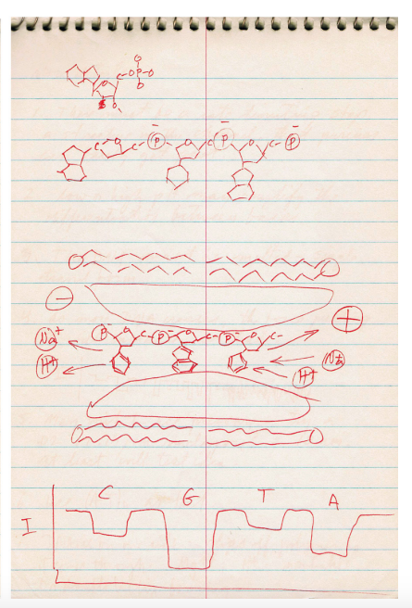
BASIC CONCEPTS
Upper chamber
A
Ionic solution
nanopore
Ionic solution
Lower chamber
time
time
time
1989 David Dreamer’s notebook

Slide 13
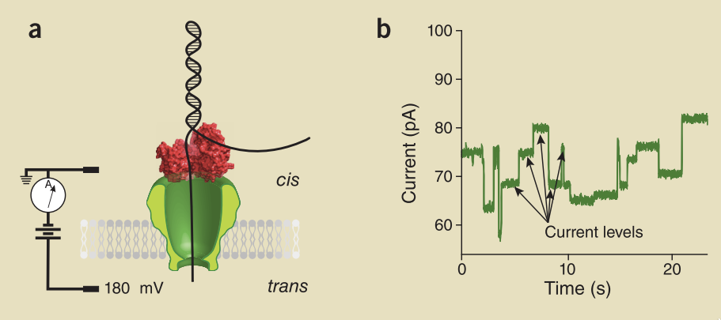


BASIC CONCEPTS
DNA polymerase
or helicase ratchets
DNA through the pore
one base per step
E. Coli amyloid
secretion channel
CsgG
450 b/sec
5’

Slide 14
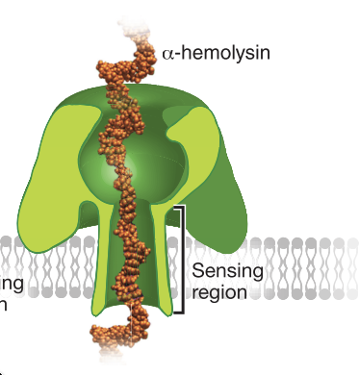
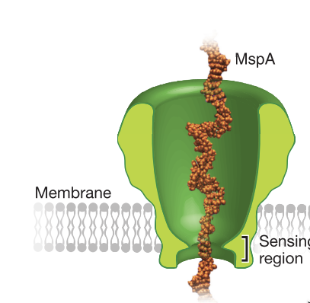
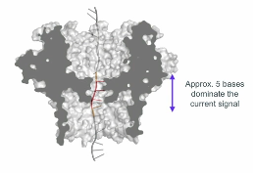

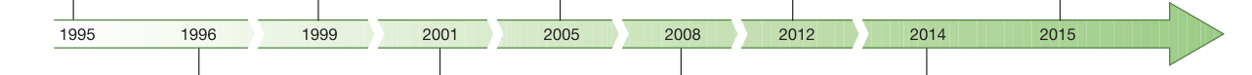
NANOPORES USED IN THE MinION
1996
2012
2017
alpha-hemolysin from
Staphylococcus aureus
Porin from
Mycobacterium smegmatis
E. Coli amyloid
secretion channel
CsgG
450 b/sec
Large
sensing region
Short
sensing region
MinION available
DNA transport
through alpha-hemolysin
Single nucleobase discrimination in a DNA strand
DNA sequencing
with phi29 DNA pol.
and MspA pore
E. coli assembled
de novo

Slide 15
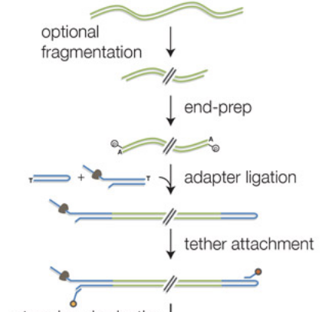
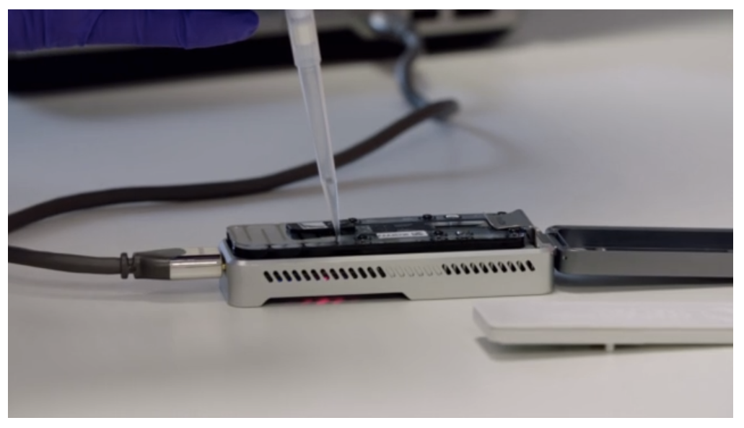
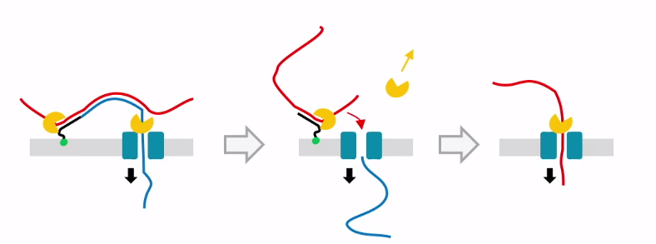
SEQUENCING PROCESS
1D² Library
(2017)
SEQUENCING

Slide 16
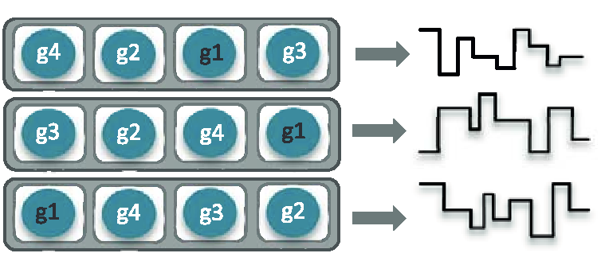
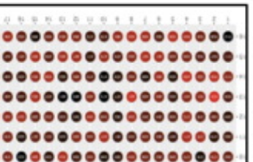
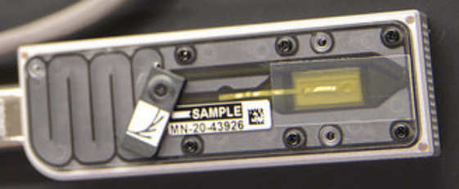
SEQUENCING PROCESS : MinION FLOW CELL
5-6 bases dominate the current signal
MinION : 512 pores
512 X 4 pores
current (pA)
time
PromethION : 144000 pores (48 x 3000)

Slide 17
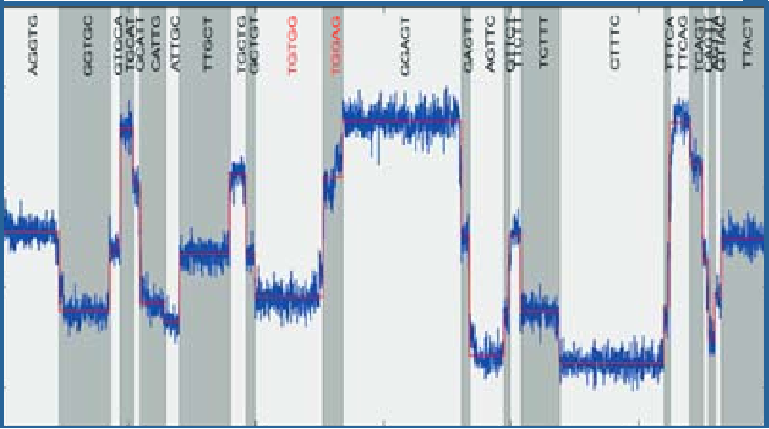
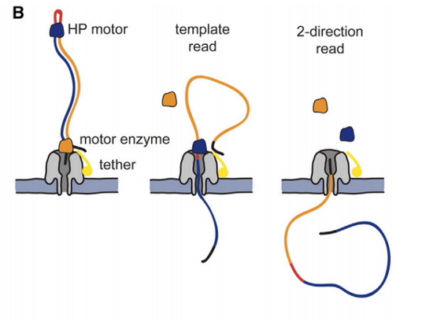
BASECALLING
….
time
….
current (pA)
hexamer
G A T C T G A GG A T G T C A G T G C C A T T
3000 values/s
GCTATG
TATGTC
AGGTGC
CTATGT
GGTGCT
GTGCTA
TGCTAT
5’
3’
……
……
Basecalling : finding the optimal
path of successive 6-mers
….. AGGTGCTATGTCT….

Slide 18
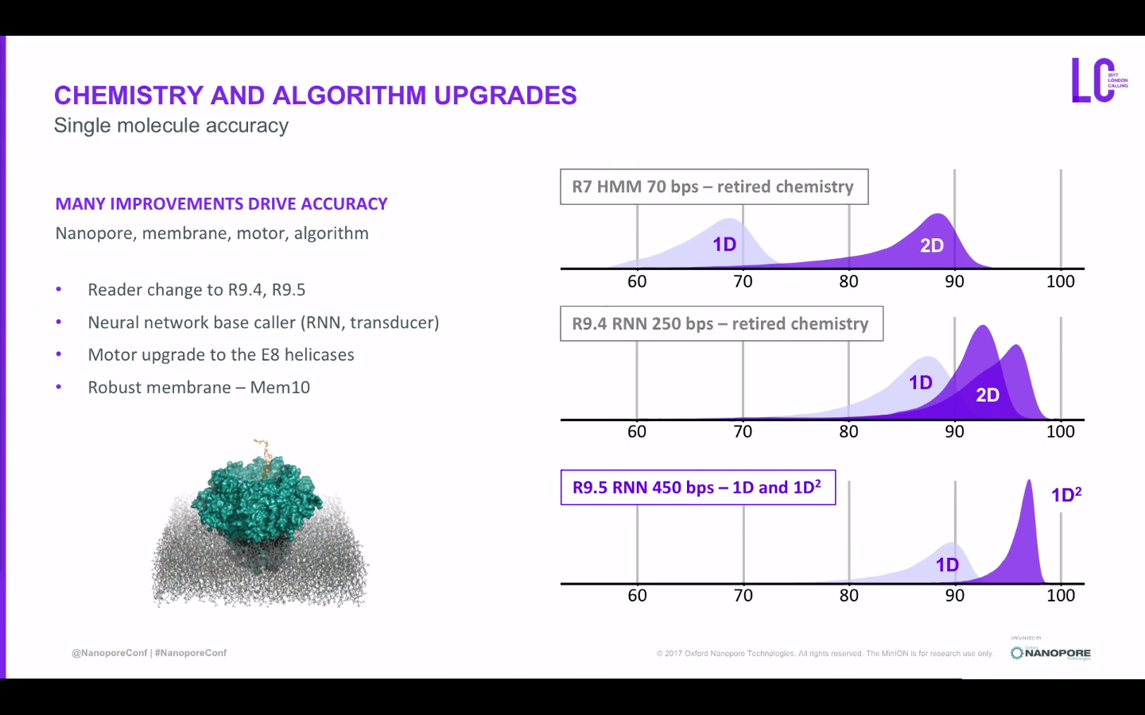
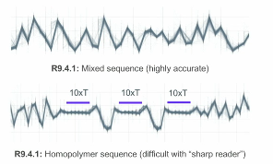
QUALITY
Homopolymers difficult to sequence

Slide 19
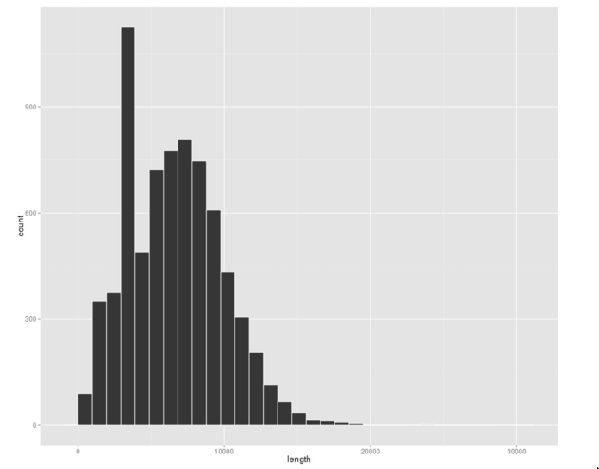
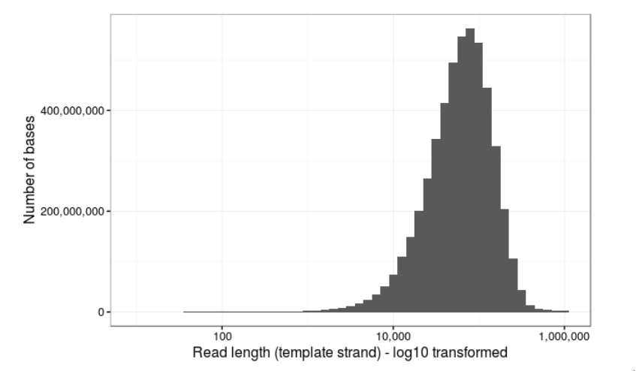
Size of sequenced DNA fragments
SIZE OF SEQUENCED DNA FRAGMENTS
Typical profile of fragment size
“Ultra long” reads
(lab.loman.net, March 2017)
0
10
20
Length of sequenced fragments (kb)
(Risse et al. GigaScience, 2015)
Size of the longest read : 778 kb
1 contig of the 4.6Mb chromosome of E. coli
obtained with just the 7 longest reads

Slide 20
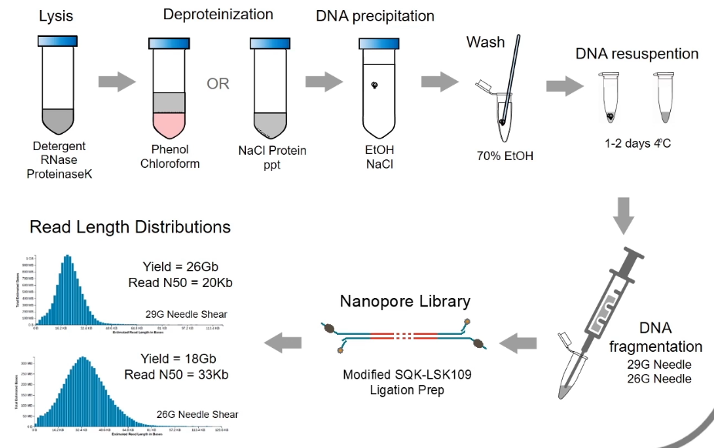
SIZE OF SEQUENCED DNA FRAGMENTS

Slide 21
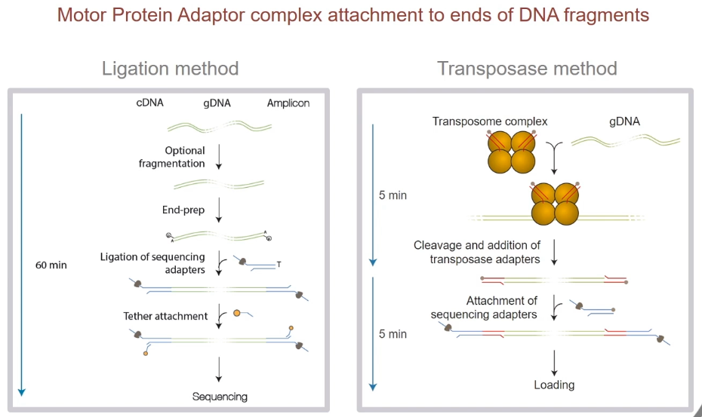
SIZE OF SEQUENCED DNA FRAGMENTS

Slide 22
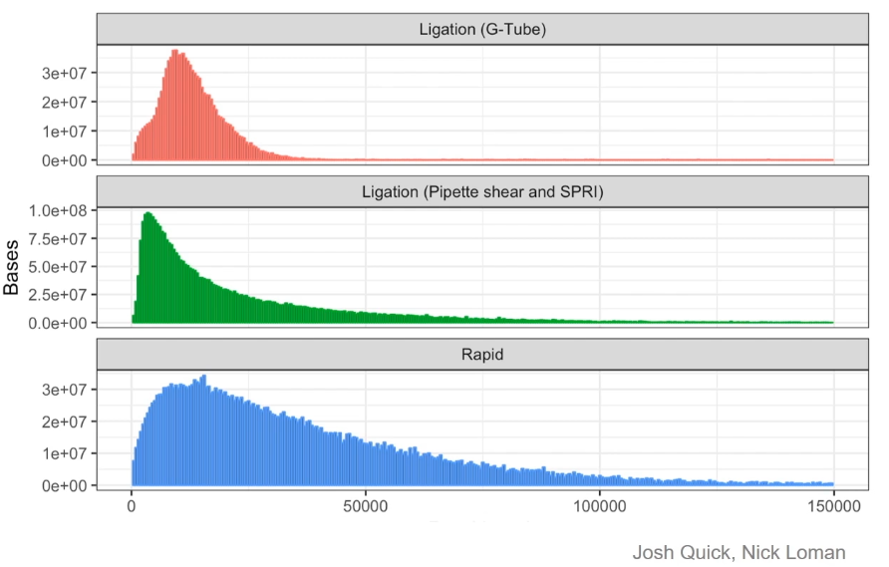
SIZE OF SEQUENCED DNA FRAGMENTS
see John Tyson’s video (ONT website)

Slide 23
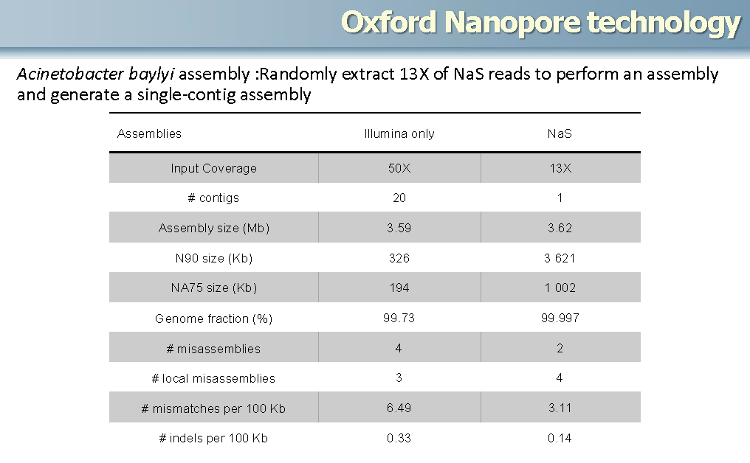
HYBRID GENOME ASSEMBLY : NANOPORE AND ILLUMINA DATA
Acinetobacter baylyi (data from Oxford Nanopore)
Illumina only
Illumina + MinION

Slide 24

NANOPORE GENOME SEQUENCING
Jan. 2018
Using nanopore reads alone assembly of a human genome :
NG50 contig size of ~6.4 Mb
covers >85% of the reference
99.88% accuracy
MHC locus on a single contig, phased over its full length
closure of 12 large (>50 kb) gaps in the reference human genome

Slide 25
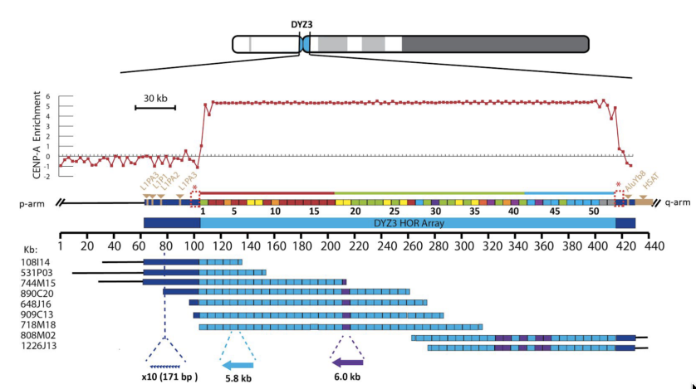
ASSEMBLY OF A HUMAN Y CENTROMERE
(Jain et al., bioRxiv, 2017)
300 kb array of 5.8 kb sequence repeated in an uninterrupted head-to-tail orientation
To date, no technology has been capable of sequencing centromeres due to requirement for extremely high-quality long reads
9 BACs

Slide 26
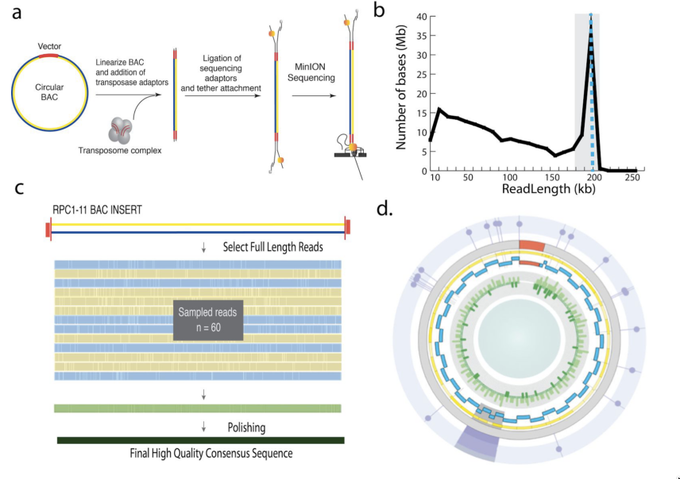
ASSEMBLY OF A HUMAN Y CENTROMERE
(Jain et al., bioRxiv, 2017)
300 kb array of 5.8 kb sequence repeated in an uninterrupted head-to-tail orientation
To date, no technology has been capable of sequencing centromeres due to requirement for extremely high-quality long reads
9 BACs
100kb to 210kb
210 kb
Final high quality consensus BAC sequence
FIRST COMPLETE SEQUENCE OF A HUMAN CENTROMERE

Slide 27
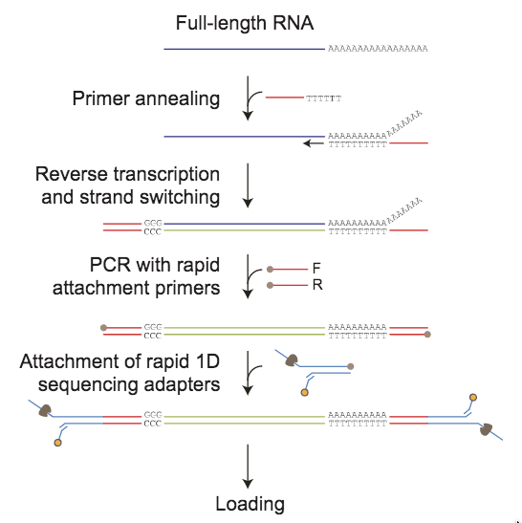
cDNA SEQUENCING
Library preparation
sequencing

Slide 28
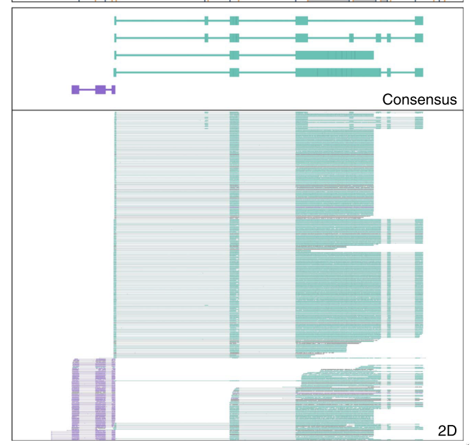
cDNA SEQUENCING
Library preparation
Detection of splice variants in surface receptor of B cells
(Byrne et al. Nat. Comm. 2017)
sequencing
Splice alignment difficult due to high (5-10%) error rate
Reads are frequently truncated from 5’ end

Slide 29
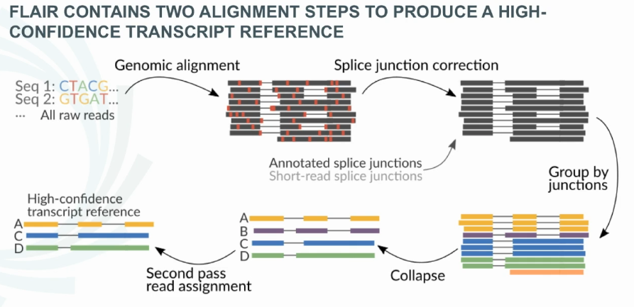
CHALLENGES OF NANOPORE TRANSCRIPTOME ANALYSIS
FLAIR : a pipeline for splicing isoform determination
Tang et al. bioRxiv 2018

Slide 30
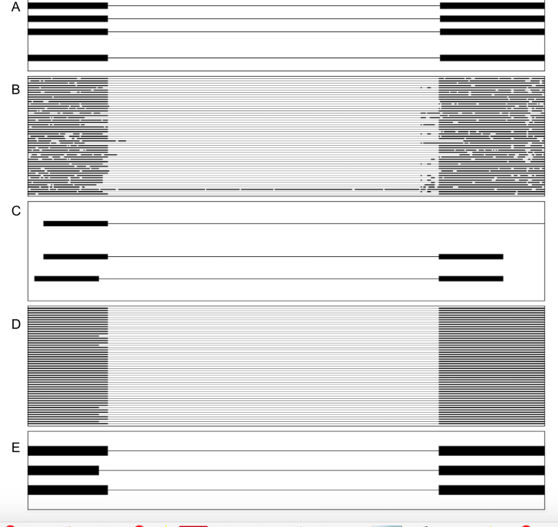
CHALLENGES OF NANOPORE TRANSCRIPTOME ANALYSIS
CHALLENGES OF NANOPORE TRANSCRIPTOME ANALYSIS
Junction correction
Clustering
2d pass alignment
Tang et al. bioRxiv 2018

Slide 31
CHALLENGES OF NANOPORE TRANSCRIPTOME ANALYSIS
FLAIR pipeline incorporates promoter chromatin states to distinguish 5’ truncations from true novel start sites
cDNA from chronic lymphocytic leukemia (CLL)
Tang et al. bioRxiv 2018

Slide 32
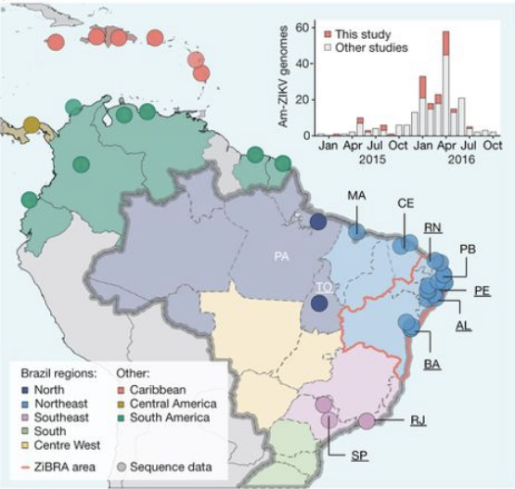
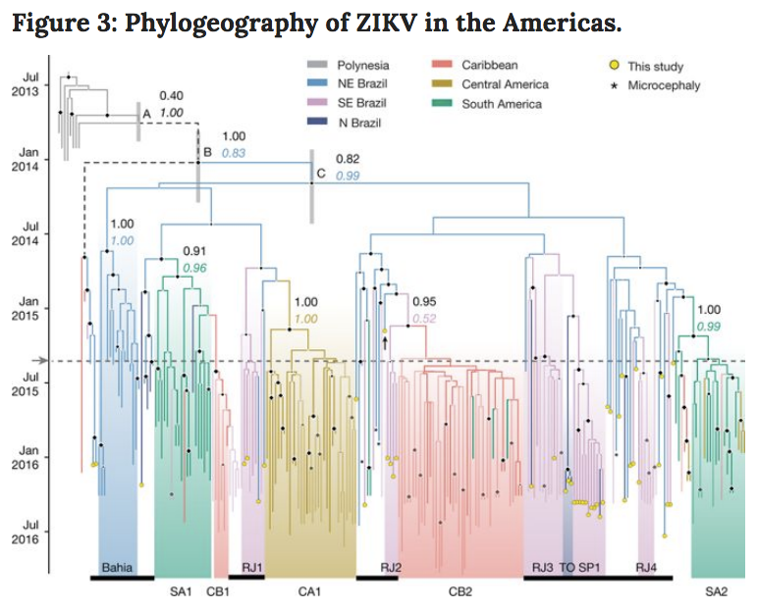
cDNA SEQUENCING
Faria et al. Nature (2017)
THE ZIBRA PROJECT : Establishment and cryptic transmission of Zika virus in Brazil and the Americas
Mobile genomics laboratory that travelled through northeast Brazil during June 2016.
The ZiBRA laboratory screened 1,330 samples (blood) from patients in 82 municipalities across 5 federal states
The MinION protocol does not require an Internet connection for analysis, making it suitable for field applications
Viral RNA genome : + sense, 10 kb
Viral consensus sequences can be achieved in 1-2 days.
ZIKV was present in northeast Brazil by February 2014 and is likely to have disseminated from there, nationally and internationally, before the first detection of ZIKV in the Americas.

Slide 33
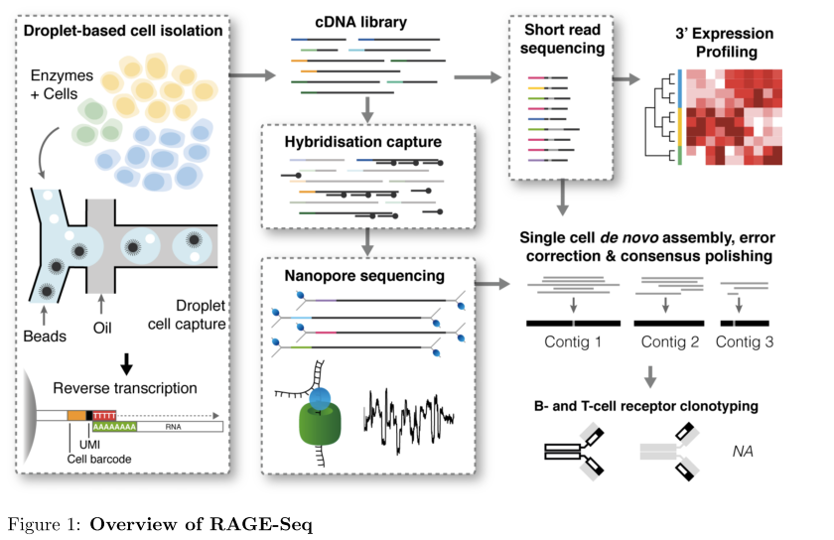
COUPLING NANOPORE and SINGLE CELL cDNA SEQUENCING
High-throughput targeted long-read single cell sequencing reveals the clonal and transcriptional landscape of lymphocytes
Singh et al., bioRxiv, 2018
RAGE-seq (Repertoire And Gene Expression sequencing): high-throughput deep single cell profiling combines targeted long-read sequencing with short-read transcriptome of barcoded single cell libraries
10x Chromium Single Cell 3’
(V2 chemistry)
T or B cell antigen receptor mRNA
Tracking of somatic mutation, alternate splicing and clonal evolution of T and B lymphocytes

Slide 34
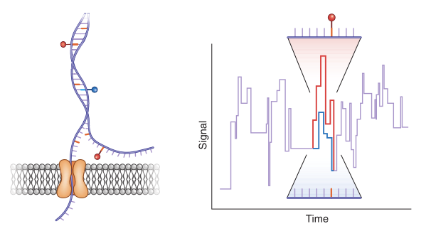
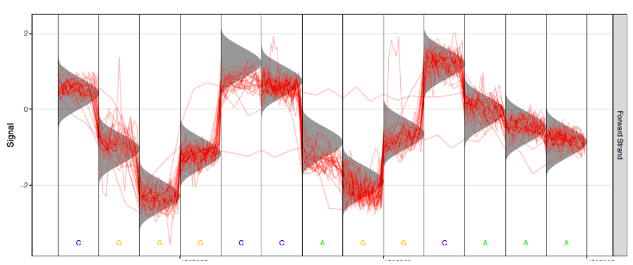
DETECTION OF MODIFIED BASES USING NANOPORE
Electric signal
Canonical base distribution

Slide 35
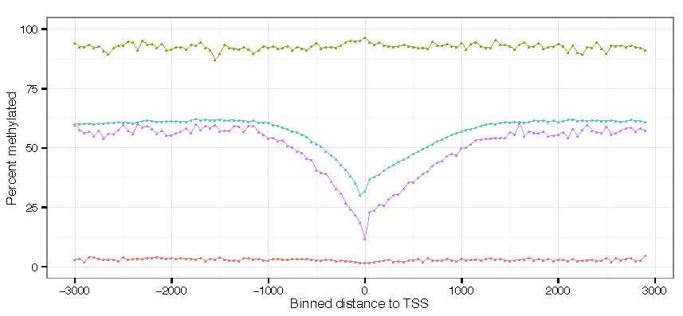
modified bases modified currents
DETECTION OF MODIFIED BASES USING NANOPORE
Detection of methylated cytosine (m5C) in CpG sites in the human genome
bisulfite
MinION
Distance to TSS
bp
Simpson et al., Nat. Methods, 2017
Softwares available:
Simpson et al., 2017, Nat. Methods
Rand et al., 2017, Nat. Methods

Slide 36
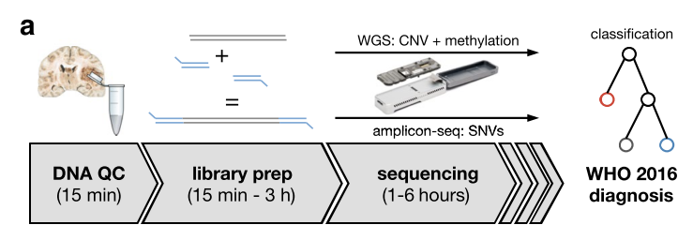
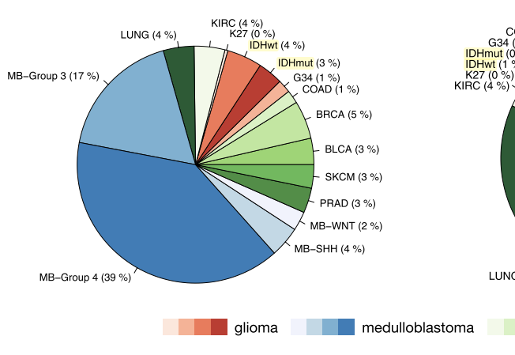
DETECTION OF MODIFIED BASES USING NANOPORE
Same-day genomic and epigenomic diagnosis of brain tumors (gliomas, medulloblastomas)
using real-time nanopore sequencing
Euskirchen et al., Acta Neuropathol. (2017)
analysis (5-6 hours)
Nanopore sequencing allows same-day detection of structural variants, point mutations, and methylation profiling using a single device with negligible capital cost.
It outperforms hybridization-based and current sequencing technologies aiming to make precision medicine possible for every cancer patient.

Slide 37
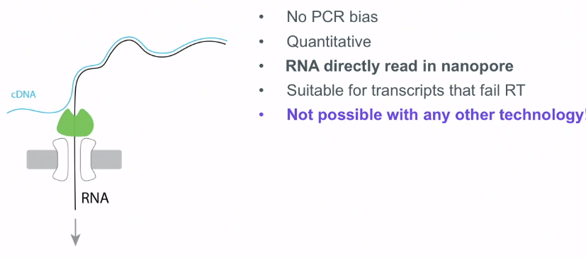
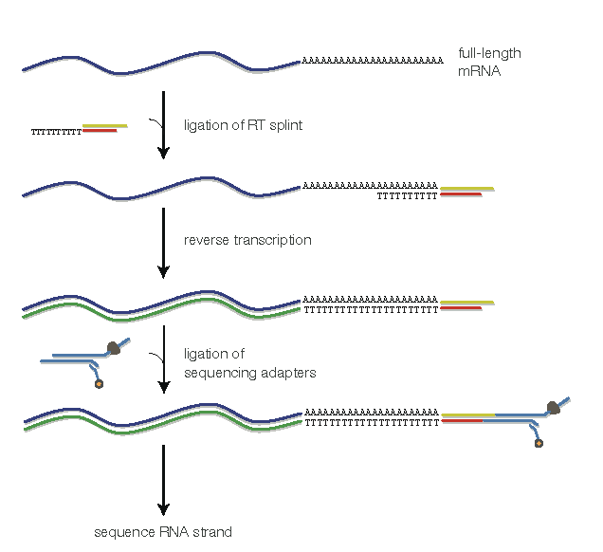
DIRECT RNA SEQUENCING
Library preparation
RNA directly sequenced in nanopore
sequencing

Slide 38
ILLUMINA cDNA vs NANOPORE DIRECT RNA
Nanopore
direct RNA
Illumina
Nanopore RNA direct
(read number ; Log scale)
Illumina Truseq
Sessegolo et al. Sci. Reports 2019

Slide 39
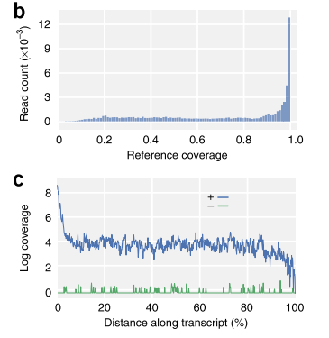
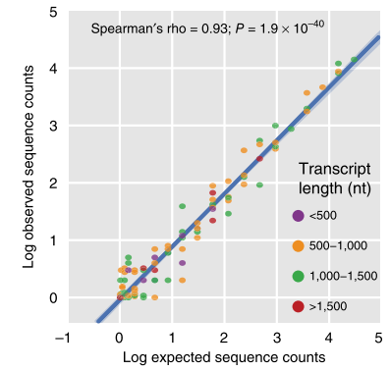
DIRECT RNA SEQUENCING / SPIKE-IN CONTROLS
Garalde et al. Nat. Methods 2018

Slide 40
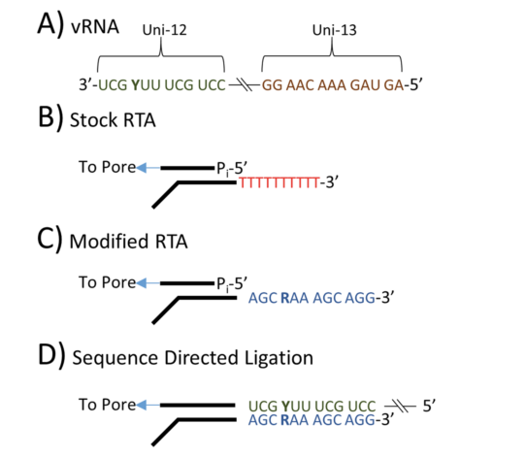
DIRECT RNA SEQUENCING
Direct RNA Sequencing of the complete Influenza A Virus Genome
Keller et al. Scientific Reports, Sept. 2018
For the first time a complete genome of an RNA virus sequenced in its original form
Influenza A viruses are negative-sense segmented RNA viruses (8 segments)
sequencing of complete genome with 100% nucleotide coverage, 99% consensus identity
Potential to identify and quantify splice variants, base modifications
not practically measurable with current methods

Slide 41

ALLELE SPECIFIC ISOFORM ANALYSIS
Nanopore native RNA sequencing of a human poly(A) transcriptome
34 genes with discordant allele specificity in two isoforms
Workman et al.Nat. Methods nov. 2019

Slide 42
DIRECT RNA SEQUENCING : DETECTION OF MODIFIED BASES
Library preparation
Detection of m6A modification
in RNA molecules
Reference position
sequencing
Smith et al. PLOS ONE 2019

Slide 43
DIRECT RNA SEQUENCING : DETECTION OF MODIFIED BASES
Detection of m6A in different sites
Lorenz et al. RNA nov. 2019

Slide 44

RECENT IMPROVEMENTS
“one-reader” pore has difficulty to read homopolymers
R9.4.1

Slide 45
RECENT IMPROVEMENTS
R9.4.1
2019
R10
“two-readers”

Slide 46

RECENT IMPROVEMENTS
Consensus accuracy (R10 flow cell)
R9.4.1
2019
R10
“two-readers”
“two-readers” flow cell can reach Q>50

Slide 47
Conclusions
Very fast-evolving technologies – Strong competition
PacBio
Maximum read length : 200 kb
Error rate compensated by highly accurate circular consensus sequencing (CCS) reads
Sequencing of cDNAs (resolution of alternative splicing)
Detection of modified DNA with context effects (preferentially 6mA)
Nanopore
Very light sequencing system
Very long reads : maximum length >> 200 kb
Problems with homopolymers : solution with “two-readers” pore
Sequencing of cDNAs (resolution of alternative splicing)
Detection of modified DNA with context effects (preferentially 5mC)
Direct sequencing of RNA
Direct detection of modified RNA (6mA)

